Slide 1
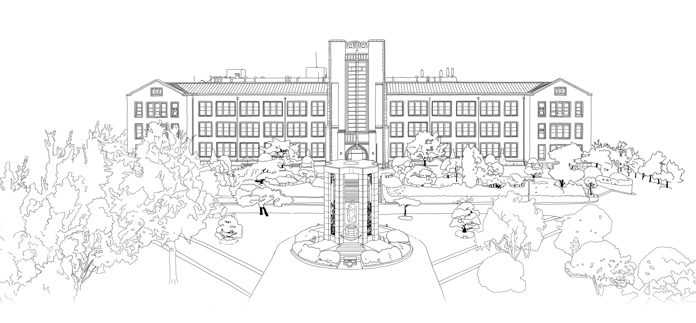


Introduction to Algorithms
DongYeon Kim
Department of Multimedia Engineering
Dongguk University

Slide 2
Contents
Chapter.3 Data Structures
Elementary Data Structures
Stacks and queues
Linked lists
Implementing pointers and objects
Representing rooted trees
Hash Tables
Direct-address tables
Hash tables
Hash functions
Open addressing
Binary Search Trees
What is a binary search tree?
Querying a binary search tree
Insertion and deletion
Red-Black Trees
Properties of red-black trees
Rotations
Insertion
Deletion
Augmenting Data Structures
Dynamic order statistics
How to augment a data structure
Interval trees

Slide 3
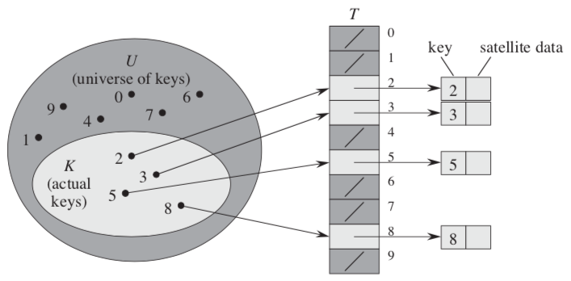
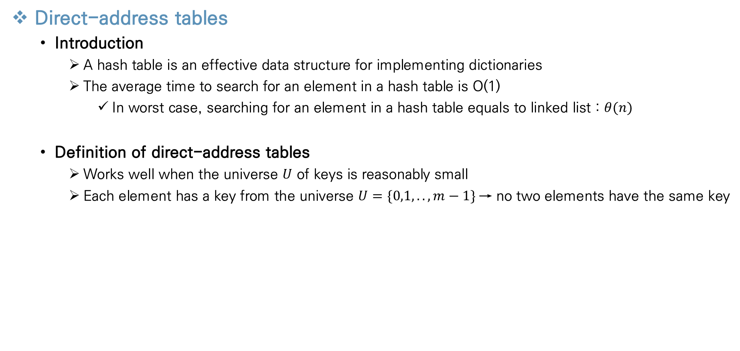
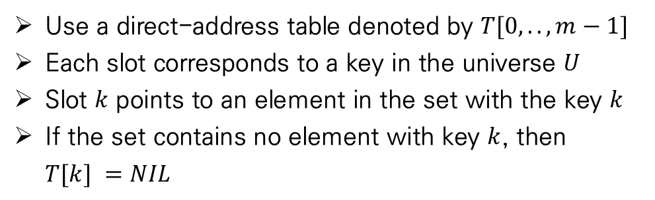
Hash Tables
Direct-address tables
Introduction
A hash table is an effective data structure for implementing dictionaries
The average time to search for an element in a hash table is O(1)
In worst case, searching for an element in a hash table equals to linked list : $θ(n)$
Definition of direct-address tables
Works well when the universe $U$ of keys is reasonably small
Each element has a key from the universe $U=\{0,1,..,m−1\}$→ no two elements have the same key
Use a direct-address table denoted by $T[0,..,m−1]$
Each slot corresponds to a key in the universe $U$
Slot $k$ points to an element in the set with the key $k$
If the set contains no element with key $k$, then $T[k] =NIL$

Slide 4
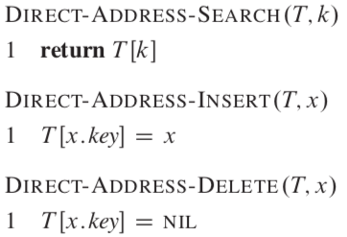
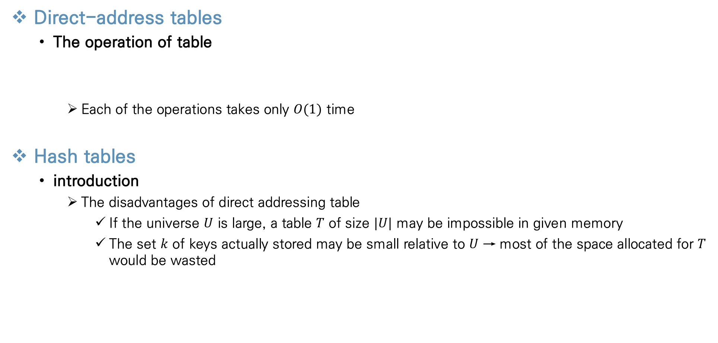
Hash Tables
Direct-address tables
The operation of table
Each of the operations takes only $O(1)$ time
Hash tables
introduction
The disadvantages of direct addressing table
If the universe $U$ is large, a table $T$ of size $|U|$ may be impossible in given memory
The set $k$ of keys actually stored may be small relative to $U$ → most of the space allocated for $T$ would be wasted

Slide 5
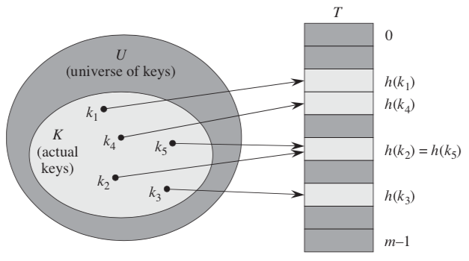
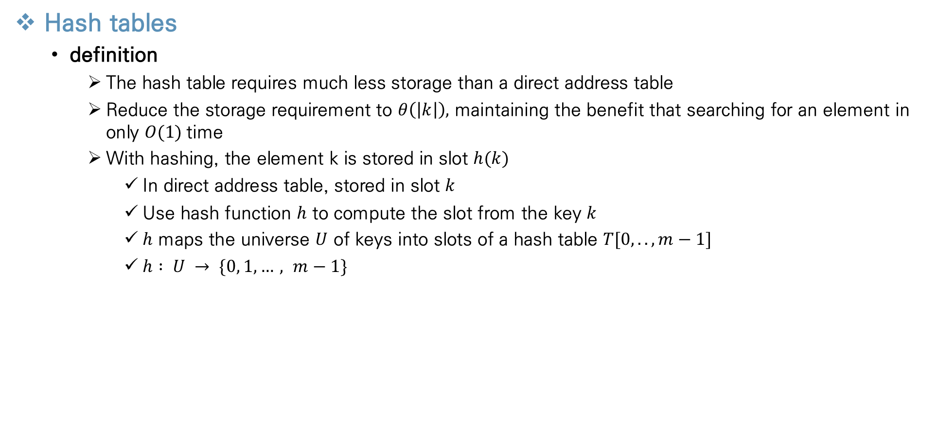
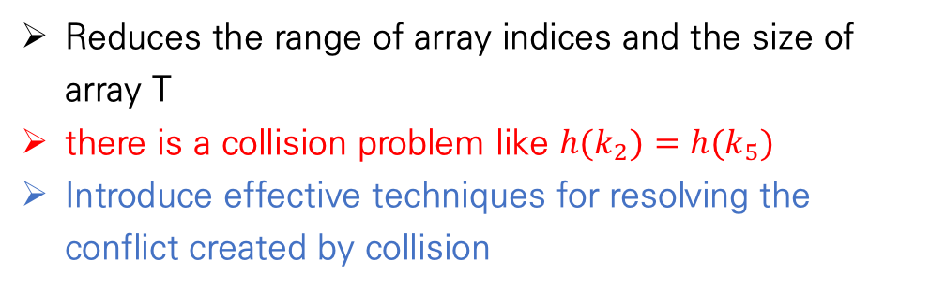
Hash Tables
Hash tables
definition
The hash table requires much less storage than a direct address table
Reduce the storage requirement to $θ\left(\left|k\right|\right),$ maintaining the benefit that searching for an element in only $O(1)$time
With hashing, the element k is stored in slot $h(k)$
In direct address table, stored in slot $k$
Use hash function $h$ to compute the slot from the key $k$
$h$ maps the universe $U$ of keys into slots of a hash table $T[0,..,m−1]$
$h : U → \{0, 1,…, m−1\}$
Reduces the range of array indices and the size of array T
there is a collision problem like $h(k_{2})=h(k_{5})$
Introduce effective techniques for resolving the conflict created by collision

Slide 6
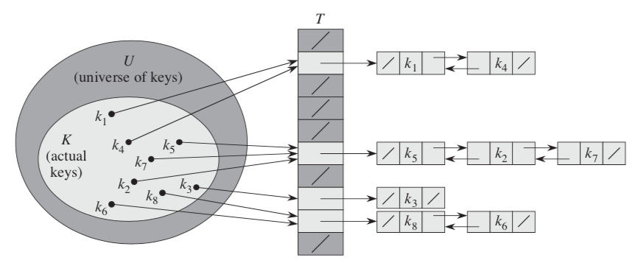

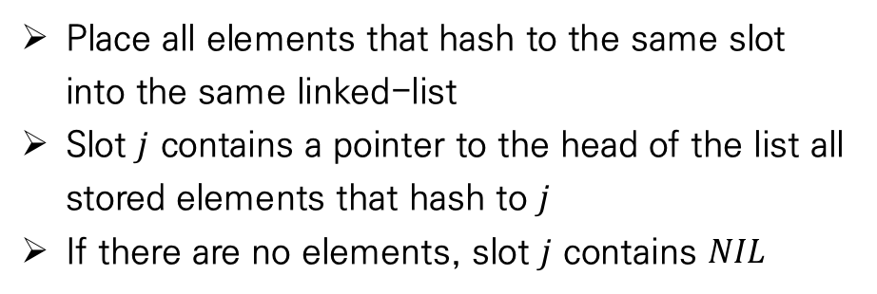
Hash Tables
Hash tables
problems
The ideal solution would be to avoid collision
$|U|>m$, must be at least two keys that have the same hash value
Avoiding collisions altogether is impossible
Present the simplest collision resolution technique called chaning
Collision resolution by chaning
Place all elements that hash to the same slot into the same linked-list
Slot $j$ contains a pointer to the head of the list all stored elements that hash to $j$
If there are no elements, slot $j$ contains $NIL$

Slide 7
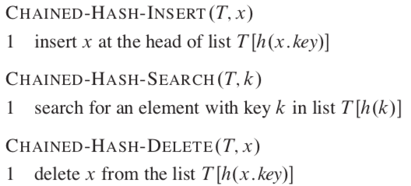
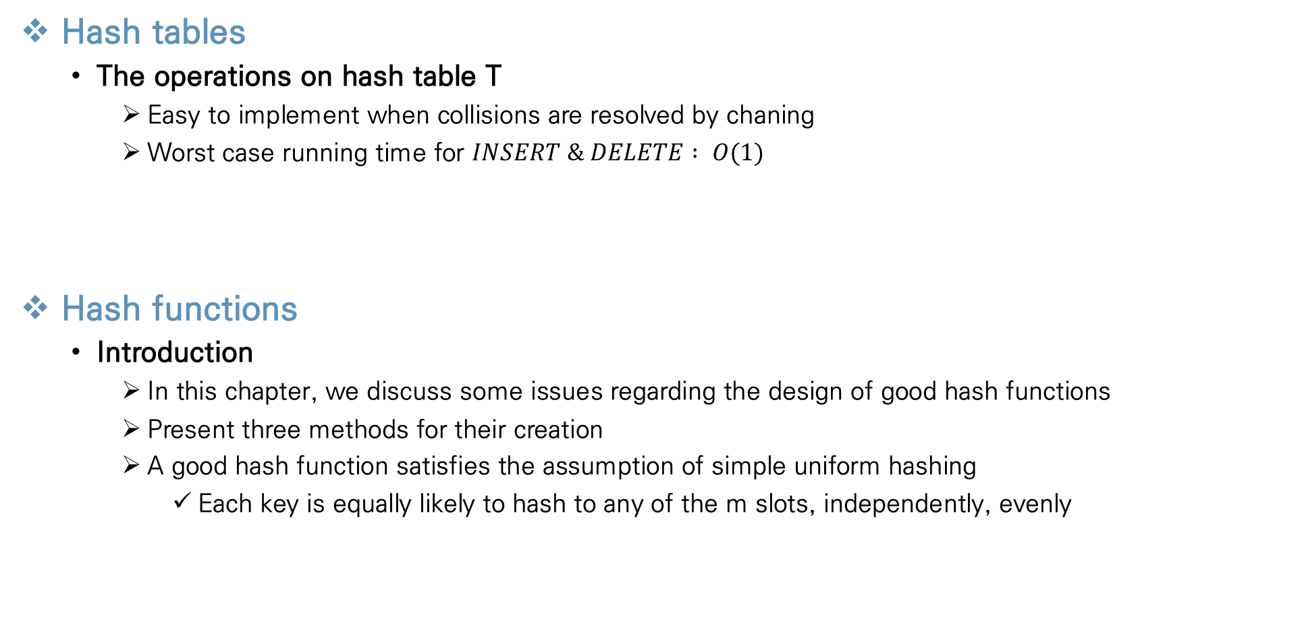
Hash Tables
Hash tables
The operations on hash table T
Easy to implement when collisions are resolved by chaning
Worst case running time for $INSERT \& DELETE : O(1)$
Hash functions
Introduction
In this chapter, we discuss some issues regarding the design of good hash functions
Present three methods for their creation
A good hash function satisfies the assumption of simple uniform hashing
Each key is equally likely to hash to any of the m slots, independently, evenly

Slide 8
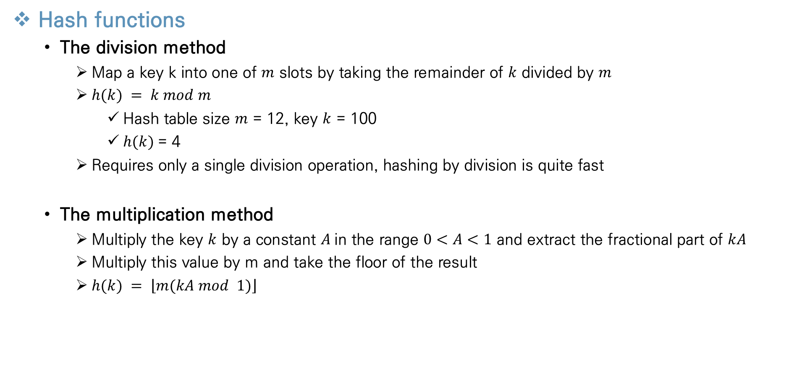
Hash Tables
Hash functions
The division method
Map a key k into one of $m$ slots by taking the remainder of $k$ divided by $m$
$h(k) = k mod m$
Hash table size $m$ = 12, key $k$ = 100
$h(k)$= 4
Requires only a single division operation, hashing by division is quite fast
The multiplication method
Multiply the key $k$ by a constant $A$in the range $0<A<1$ and extract the fractional part of $kA$
Multiply this value by m and take the floor of the result
$h(k) = \left\lfloor m(kA mod 1)\right\rfloor$
Represent the fractional part of $kA$, that is $kA−\left\lfloor kA\right\rfloor$

Slide 9
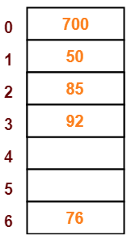
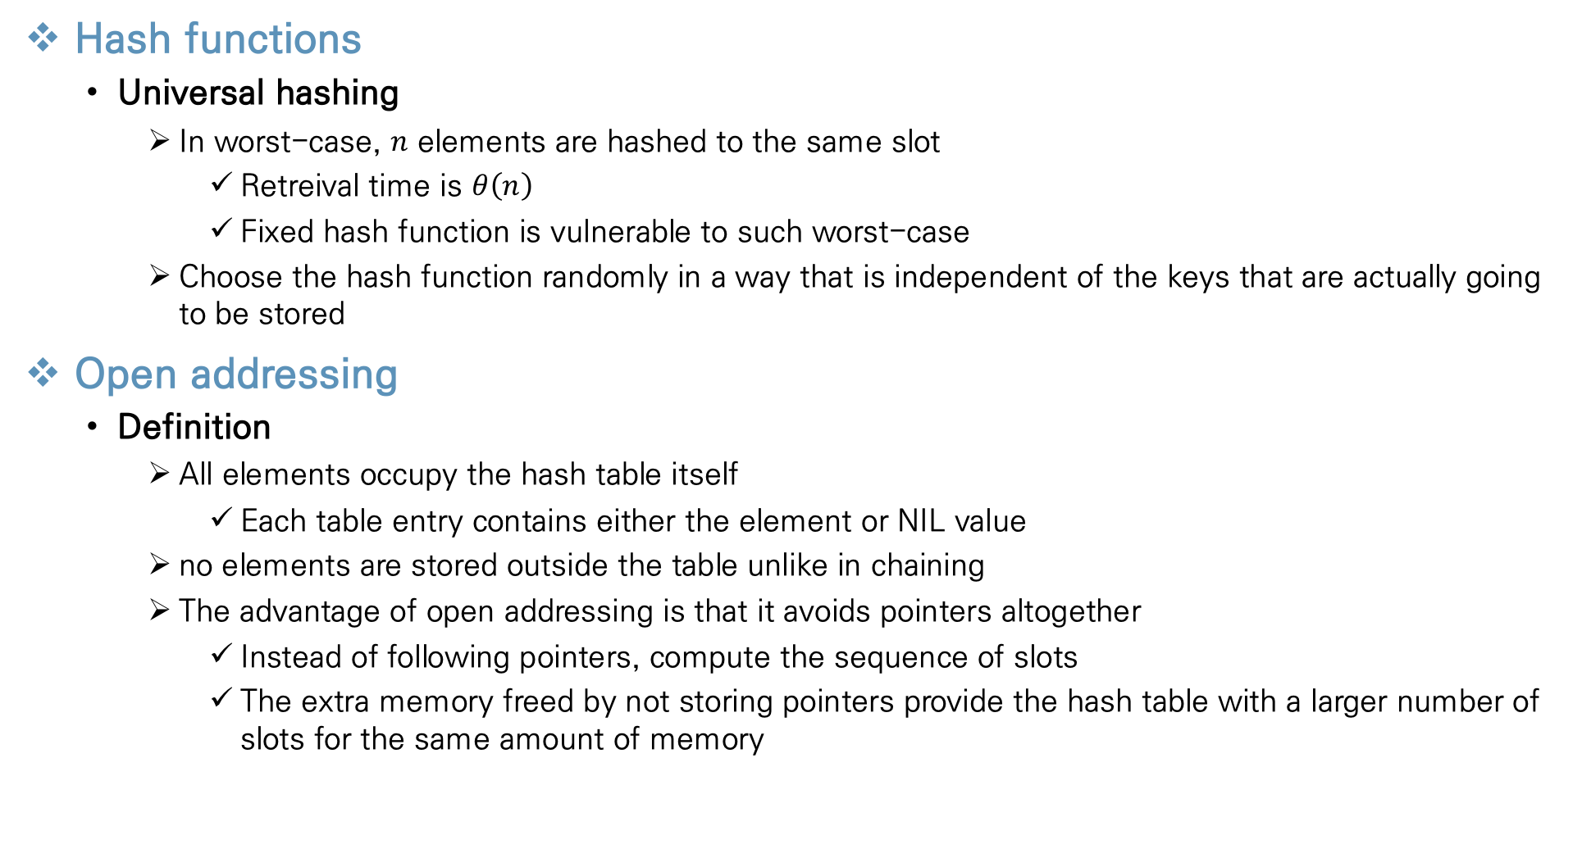

Hash Tables
Hash functions
Universal hashing
In worst-case, $n$ elements are hashed to the same slot
Retreival time is $θ\left(n\right)$
Fixed hash function is vulnerable to such worst-case
Choose the hash function randomly in a way that is independent of the keys that are actually going to be stored
Open addressing
Definition
All elements occupy the hash table itself
Each table entry contains either the element or NIL value
no elements are stored outside the table unlike in chaining
The advantage of open addressing is that it avoids pointers altogether
Instead of following pointers, compute the sequence of slots
The extra memory freed by not storing pointers provide the hash table with a larger number of slots for the same amount of memory
$$NIL$$
$$NIL$$

Slide 10
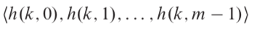
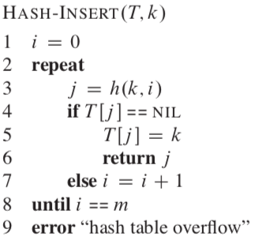
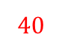
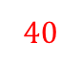
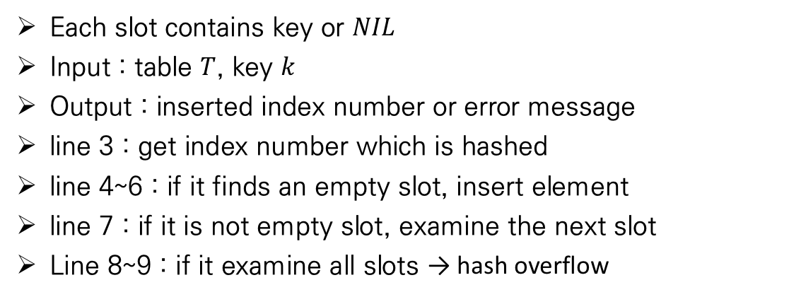

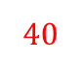
Hash Tables
Open addressing
Insertion
Probe the hash table until we find an empty slot
Require that for every key k, there is a prob sequence
probe number
Every hash table slots are considered as a slot for a new key as the table fills up
$$40$$
$$40$$
$$40$$
$$NIL$$
Each slot contains key or $NIL$
Input : table $T$, key $k$
Output : inserted index number or error message
line 3 : get index number which is hashed
line 4~6 : if it finds an empty slot, insert element
line 7 : if it is not empty slot, examine the next slot
Line 8~9 : if it examine all slots → hash overflow

Slide 11
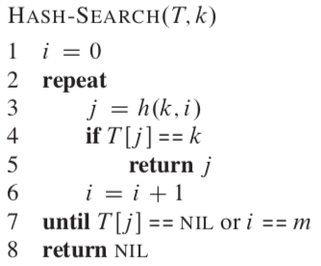
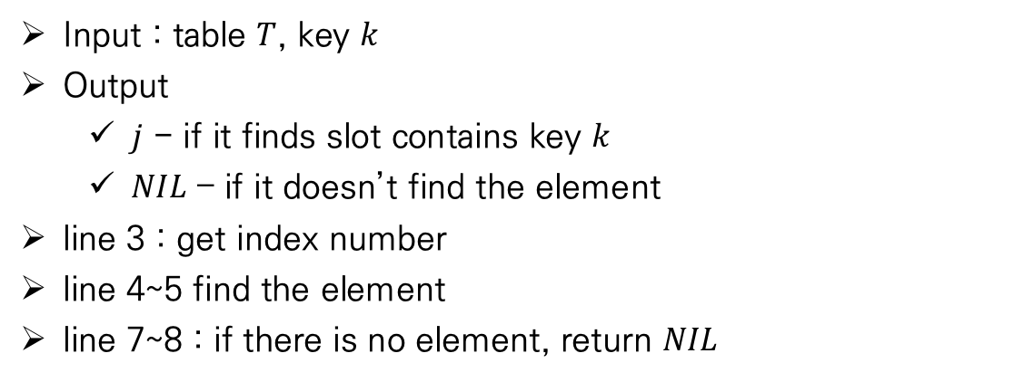
Hash Tables
Open addressing
Search
The algorithm for searching key k probes the same sequence of slots that the insertion algorithm examined when key k was inserted
Search can terminate unsuccessfully when it finds an empty slot
Since k would has been inserted there
Not later in its probe sequence
Input : table $T$, key $k$
Output
$j$ - if it finds slot contains key $k$
$NIL$ – if it doesn’t find the element
line 3 : get index number
line 4~5 find the element
line 7~8 : if there is no element, return $NIL$

Slide 12
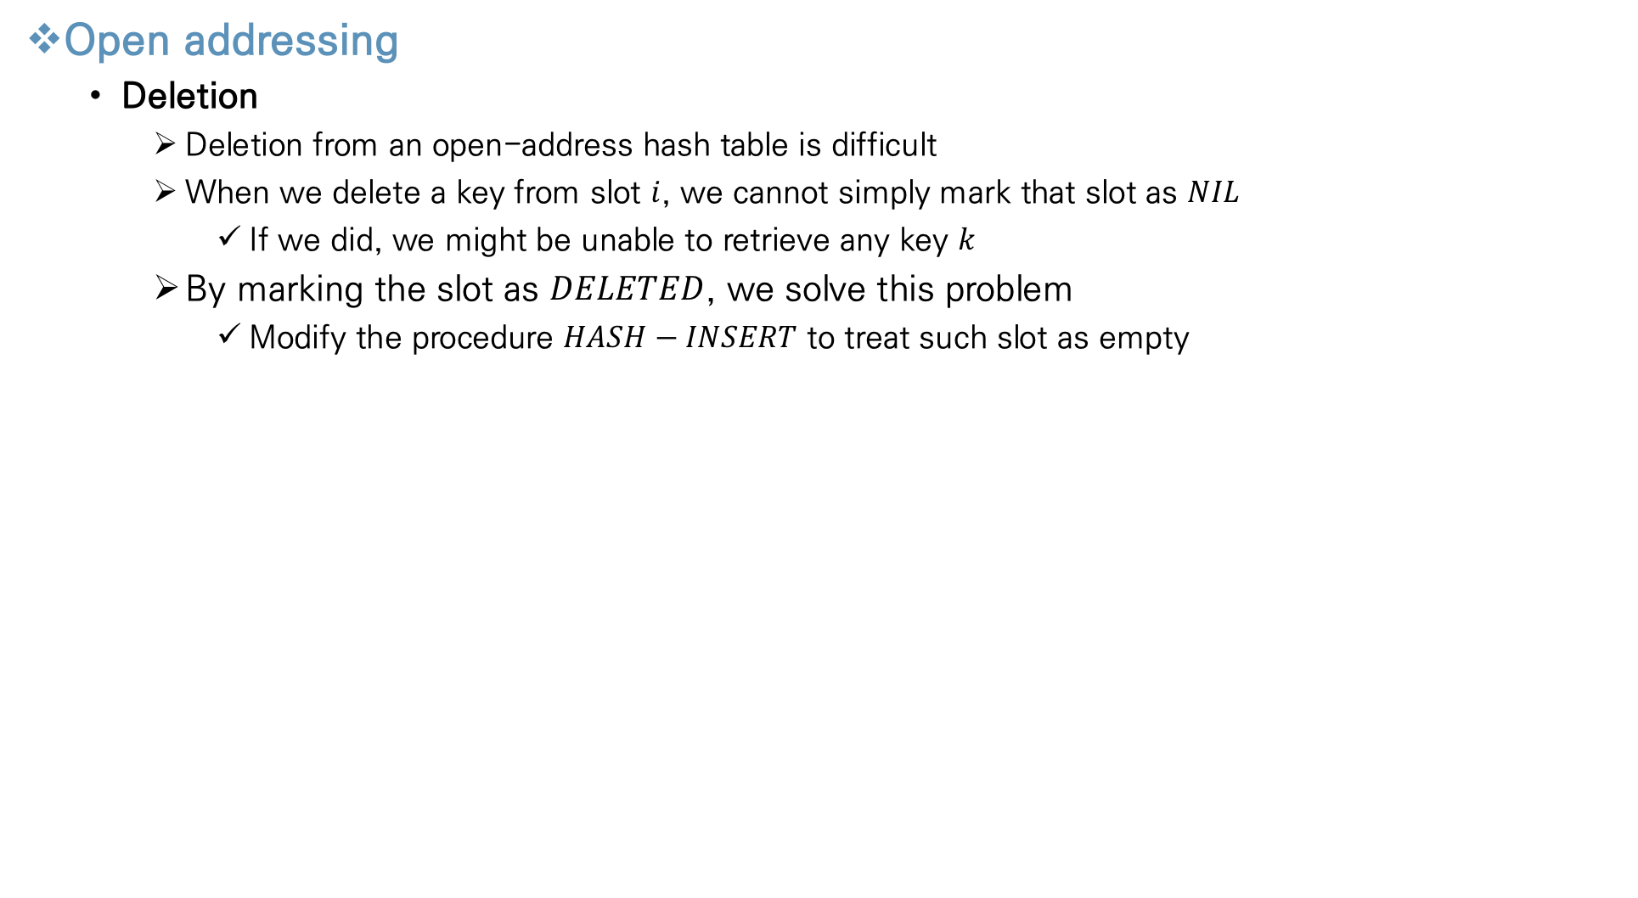


Hash Tables
Open addressing
Deletion
Deletion from an open-address hash table is difficult
When we delete a key from slot $i$, we cannot simply mark that slot as $NIL$
If we did, we might be unable to retrieve any key $k$
By marking the slot as $DELETED$, we solve this problem
Modify the procedure $HASH−INSERT$ to treat such slot as empty
$$NIL$$
$$NIL$$
$$NIL$$

Slide 13
Contents
Chapter.3 Data Structures
Elementary Data Structures
Stacks and queues
Linked lists
Implementing pointers and objects
Representing rooted trees
Hash Tables
Direct-address tables
Hash tables
Hash functions
Open addressing
Binary Search Trees
What is a binary search tree?
Querying a binary search tree
Insertion and deletion
Red-Black Trees
Properties of red-black trees
Rotations
Insertion
Deletion
Augmenting Data Structures
Dynamic order statistics
How to augment a data structure
Interval trees

Slide 14
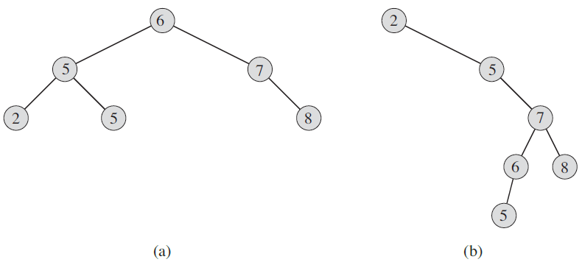
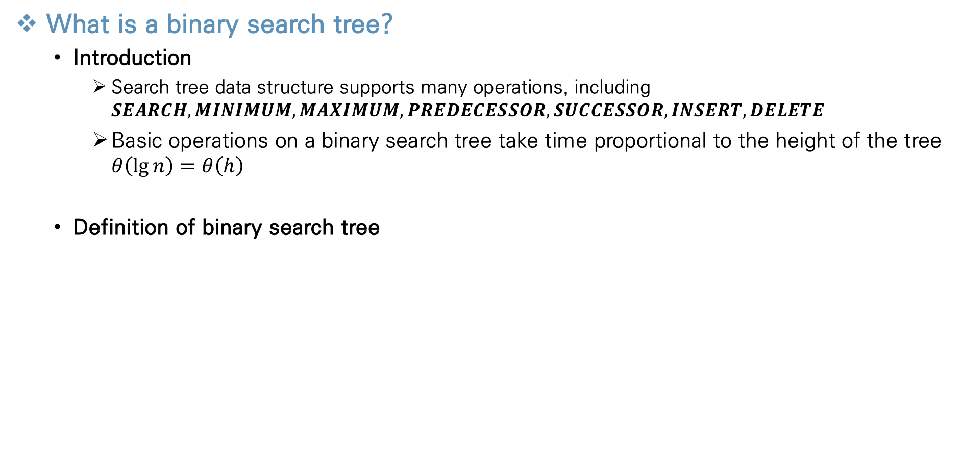
Binary Search Tree
What is a binary search tree?
Introduction
Search tree data structure supports many operations, including $SEARCH, MINIMUM, MAXIMUM, PREDECESSOR, SUCCESSOR, INSERT, DELETE$
Basic operations on a binary search tree take time proportional to the height of the tree $θ\left(\lg{n}\right)=θ\left(h\right)$
Definition of binary search tree
Represent such a tree by a linked data structure in which each node is an object
Each node contains a key, satellite data, attributes left, right, and p

Slide 15
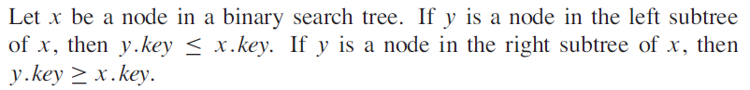
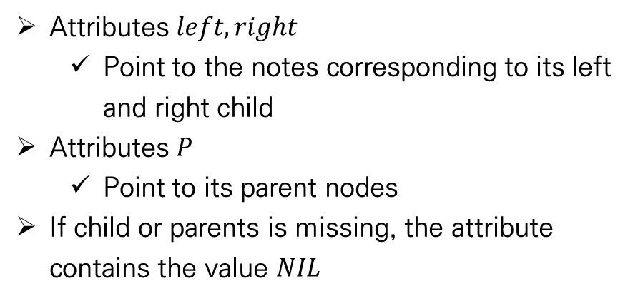
Binary Search Tree
What is a binary search tree?
Definition of binary search tree
Binary search tree property
This property holds for every node in tree
Attributes $left, right$
Point to the notes corresponding to its left and right child
Attributes $P$
Point to its parent nodes
If child or parents is missing, the attribute contains the value $NIL$

Slide 16
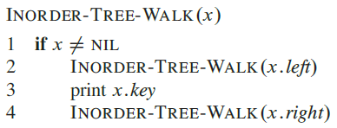

Binary Search Tree
What is a binary search tree?
Inorder-tree-walk
BST property allows us to print out all the key in a BST in sorted order
Print the root of a subtree between printing the left and right subtree (inorder)
Preorder : print the root before the values in either subtree
Postorder : print the root after the values in either subtree
Takes $θ(n)$ time to walk an n-node BST
After the initial call, the procedure calls itself recursively exactly twice for each node
4
2
5
1
3
6

Slide 17
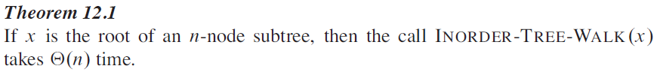
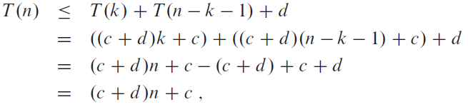
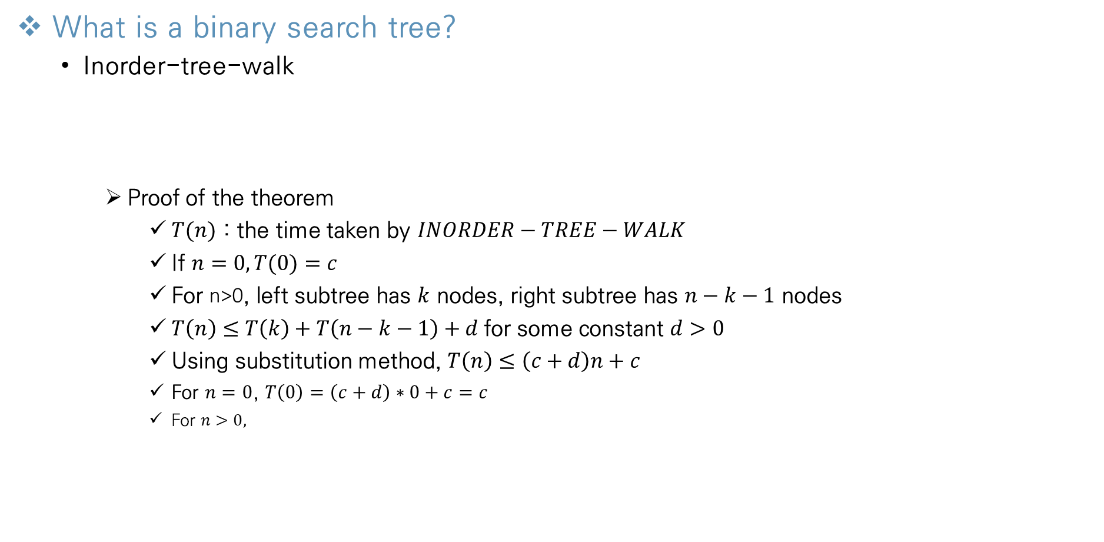
Binary Search Tree
What is a binary search tree?
Inorder-tree-walk
Proof of the theorem
$T(n)$ : the time taken by $INORDER−TREE−WALK$
If $n=0, T(0)=c$
For n>0, left subtree has $k$ nodes, right subtree has $n−k−1$ nodes
$T\left(n\right)≤T\left(k\right)+T\left(n−k−1\right)+d$for some constant $d>0$
Using substitution method, $T\left(n\right)≤\left(c+d\right)n+c$
For $n=0$, $T\left(0\right)=\left(c+d\right)∗0+c=c$
For $n>0,$

Slide 18
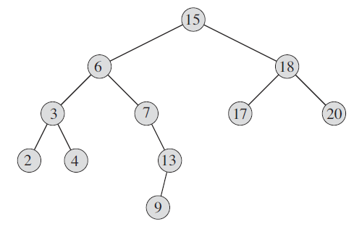

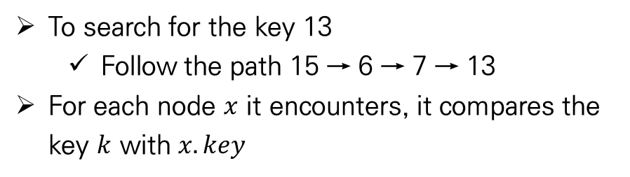
Binary Search Tree
Querying a BST
Introduction
In this section, introduce $SEARCH,MINIMUM,MAXIMUM,SUCCESSOR, PREDESSESSOR$
Show how to support each one in time $O(h)$ → height of BST is $h$
Searching
Search for a node with a given key in a BST
Input : a pointer to the root node & key $k$
Output : a pointer to a node with key $k$ or $NIL$
To search for the key 13
Follow the path 15 → 6 → 7 → 13
For each node $x$ it encounters, it compares the key $k$ with $x.key$

Slide 19
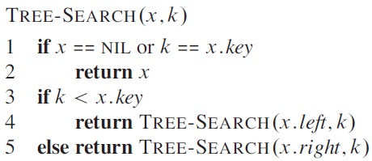
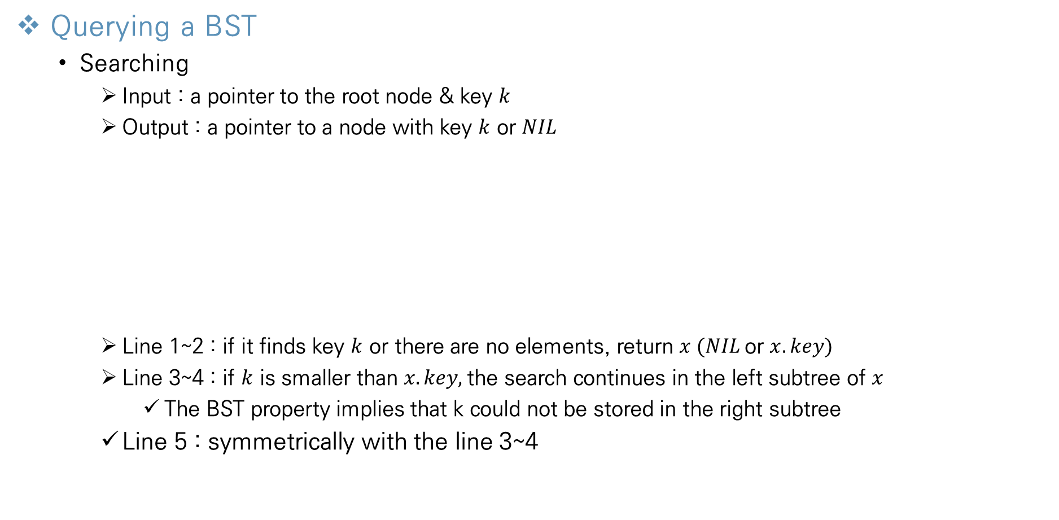
Binary Search Tree
Querying a BST
Searching
Input : a pointer to the root node & key $k$
Output : a pointer to a node with key $k$ or $NIL$
Line 1~2 : if it finds key $k$ or there are no elements, return $x (NIL$or $x.key)$
Line 3~4 : if $k$ is smaller than $x.key,$the search continues in the left subtree of $x$
The BST property implies that k could not be stored in the right subtree
Line 5 : symmetrically with the line 3~4

Slide 20
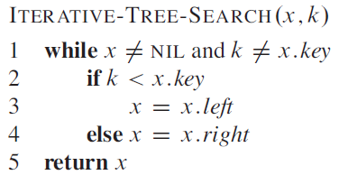

Binary Search Tree
Querying a BST
Searching
Can rewrite this procedure in a iterative fashion
The running time of $TREE−SEARCH$ is $O(h)$
$h$ is the height of tree
Encounter nodes from the root of the tree to the finding key in a simple path downward

Slide 21
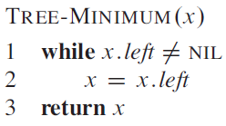
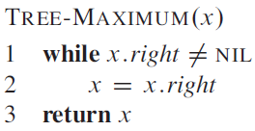
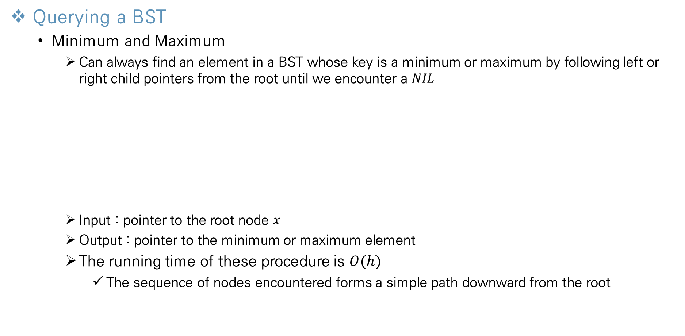
Binary Search Tree
Querying a BST
Minimum and Maximum
Can always find an element in a BST whose key is a minimum or maximum by following left or right child pointers from the root until we encounter a $NIL$
Input : pointer to the root node $x$
Output : pointer to the minimum or maximum element
The running time of these procedure is $O(h)$
The sequence of nodes encountered forms a simple path downward from the root

Slide 22
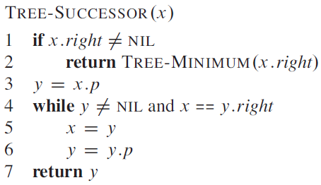
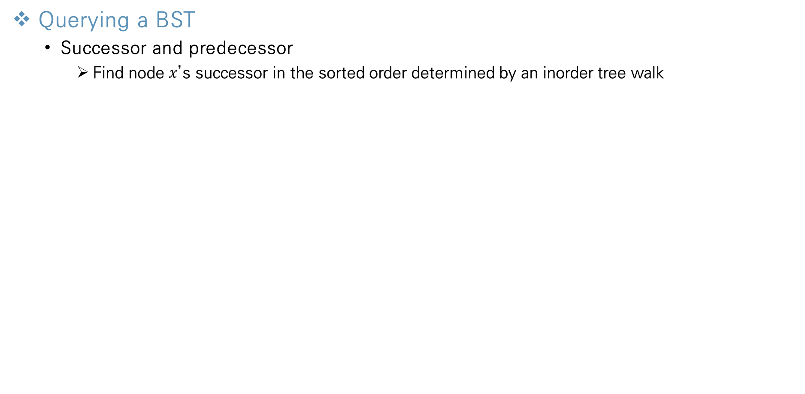
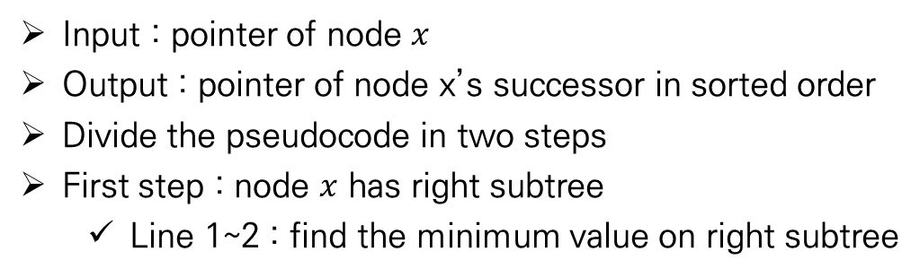
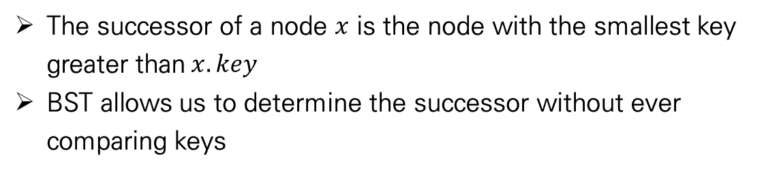
Binary Search Tree
Querying a BST
Successor and predecessor
Find node $x$’s successor in the sorted order determined by an inorder tree walk
The successor of a node $x$ is the node with the smallest key greater than$x.key$
BST allows us to determine the successor without ever comparing keys
Input : pointer of node $x$
Output : pointer of node x’s successor in sorted order
Divide the pseudocode in two steps
First step : node $x$ has right subtree
Line 1~2 : find the minimum value on right subtree

Slide 23
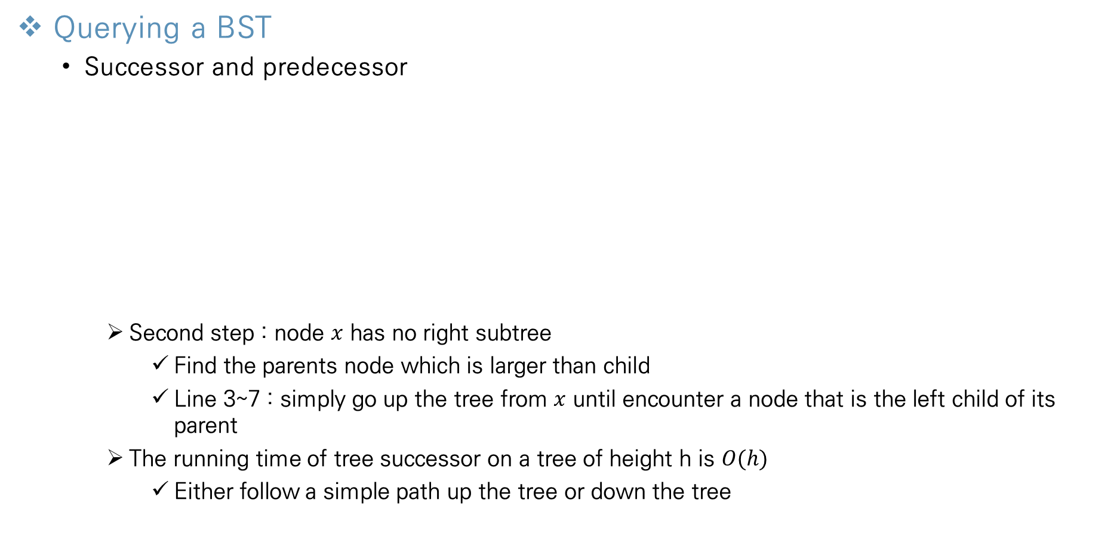
Binary Search Tree
Querying a BST
Successor and predecessor
Second step : node $x$ has no right subtree
Find the parents node which is larger than child
Line 3~7 : simply go up the tree from $x$ until encounter a node that is the left child of its parent
The running time of tree successor on a tree of height h is $O(h)$
Either follow a simple path up the tree or down the tree

Slide 24
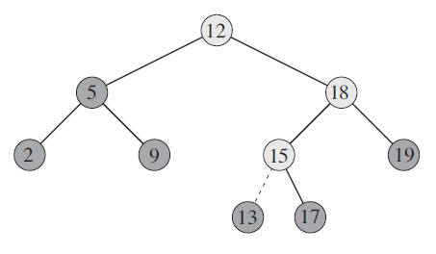
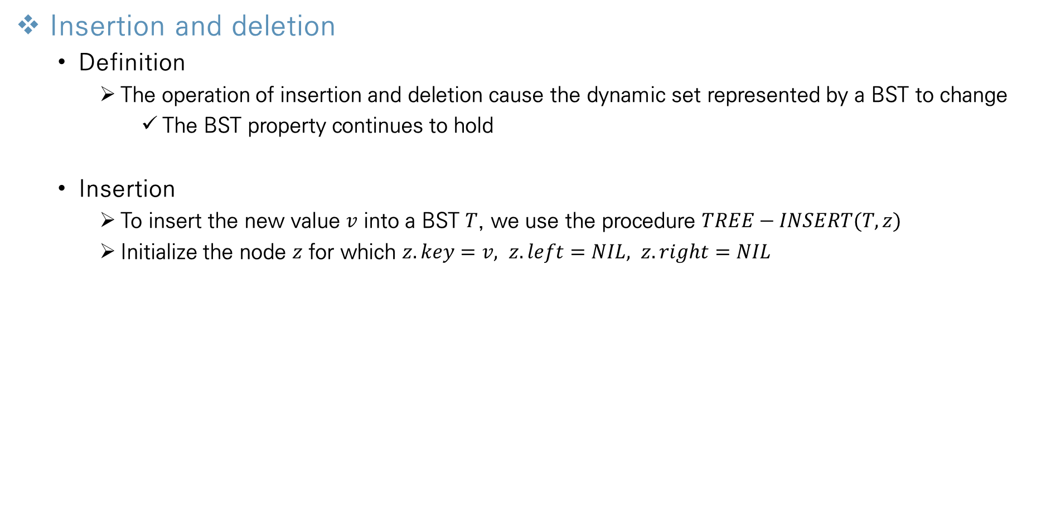
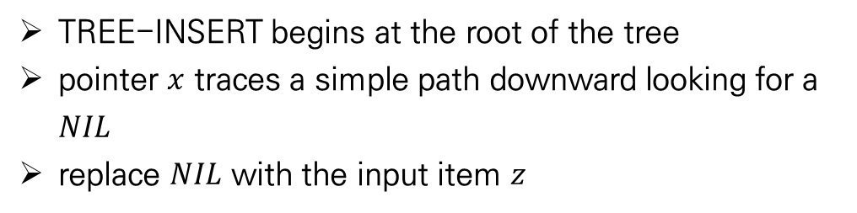
Binary Search Tree
Insertion and deletion
Definition
The operation of insertion and deletion cause the dynamic set represented by a BST to change
The BST property continues to hold
Insertion
To insert the new value $v$ into a BST $T$, we use the procedure $TREE−INSERT(T,z)$
Initialize the node $z$ for which $z.key=v, z.left=NIL, z.right=NIL$
TREE-INSERT begins at the root of the tree
pointer $x$ traces a simple path downward looking for a $NIL$
replace $NIL$ with the input item $z$

Slide 25
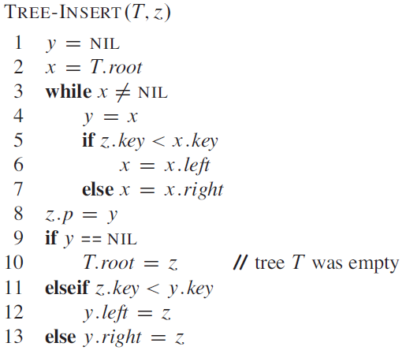

Binary Search Tree
Insertion and deletion
Insertion
Line 1~2 : initialize $x, y$
$x$: current node
$y$: parent node of $x$
Line 3~7
While loop causes two pointers to move down
Going left or right depending on the comparison of $z.key$with $x.key$until $x$becomes $NIL$
Line 8~13
Set the pointer that cause $z$ to be inserted
The running time is $O(h)$
Start from root to $NIL$

Slide 26


Binary Search Tree
Insertion and deletion
Deletion
The overall strategy for deleting a node $z$ from a BST $T$ has three basic cases
Second case
$z$ has just one child
Elevate that child to take $z$’s position by modifying $z$’s parent to replace $z$ by $z$’s child
$Delete 13 → 7.right=9→9.p=7$
First case
$z$ has no children
Simply remove it by modifying its parent to replace $z$ with $NIL$ as its child
$Delete 9 → 13.left=NIL$

Slide 27


Binary Search Tree
Insertion and deletion
Deletion
The overall strategy for deleting a node $z$ from a BST $T$ has three basic cases
In order to move subtree around within the BST, we define a subroutine $TRANSPLANT\left(T,u,v\right)$
Replace the subtree rooted at node $u$ with the subtree rooted at node $v$
Node u’s parent becomes node v’s parent
Third case
$z$ has two children
Find $z$’s successor $y$
Rest of $z$’s original right & left subtree becomes $y$’s new right & left subtree
$Delete 15 →$ find successor 17 $→17.left=6 \& 17.right=18$

Slide 28



Binary Search Tree
Insertion and deletion
Deletion
Pseudocode for $TRANSPLANT$
Line 1~2 : handle the case $v$ is root of $T$
Line 3~5 : examine $v$ is left child or right child, updating $u.p.left$or $u.p.right$
Line 6~7 : update point to parent node

Slide 29







Binary Search Tree
Insertion and deletion
Deletion
(a) : $z$ has no left child
Replace $z$ with its right child
(b) : $z$ has no right child
Replace $z$ with its left child
(c) : $z$ has both left & right child $→$ successor $y$ is $z$’s right child
Replace $z$ with its right child $y$
(d) : $z$ has both left & right child $→$ successor $y$ is not z’s right child
Replace $y$ by its own right child $x$
Replace $z$ with $y$

Slide 30



Binary Search Tree
Insertion and deletion
Deletion
Pseudocode for $TREE−DELETE$
Delete node $z$ from BST $T$
Line 1~2 or line 3~4
Only have right or left child
Replace $z$ with $z.right$ or $z.left$
Line 5
Find the minimum key in right subtree (successor $y$)
Line 10~12
If $y.p == z → y$is right child of $z$
Replace $z$ with $y$
Connect $z.left$with $y$

Slide 31

Binary Search Tree
Insertion and deletion
Deletion
Pseudocode for $TREE−DELETE$
Delete node $z$ from BST $T$
Line 6~9
Successor $y$ is not a right child of $z$
Replace $y$ with $y.right$
The running time of $TREE−DELETE$ and$TRANSPLANT$ takes constant time $O(1)$
$TREE−MINIMUM$ takes $O(h)$

Slide 32
Thank You!

